Slide 1
Tips for Improving GAN
Martin Arjovsky, Soumith Chintala, Léon Bottou, Wasserstein GAN, arXiv prepring, 2017
Ishaan Gulrajani, Faruk Ahmed, Martin Arjovsky, Vincent Dumoulin, Aaron Courville, “Improved Training of Wasserstein GANs”, arXiv prepring, 2017
Notes:
One sentence for WGAN: Using Earth Mover’s Distance to evaluate two distributions
Earth Mover’s Distance = Wasserstein Distance

Slide 2
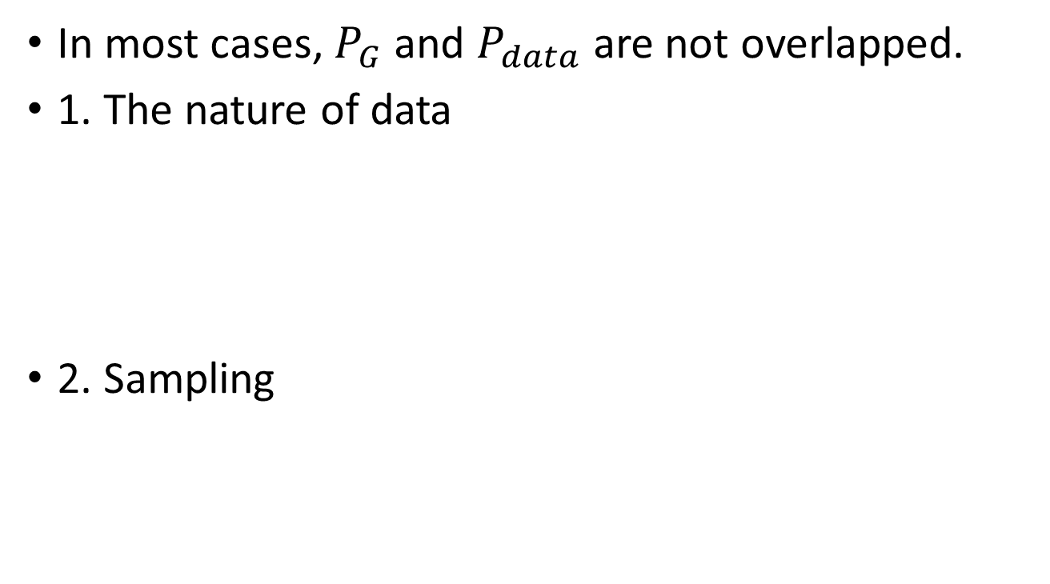
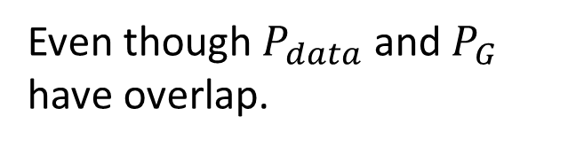
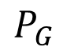
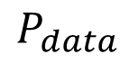
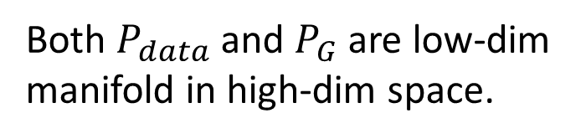
JS divergence is not suitable
In most cases, $P_{G}$ and $P_{data}$ are not overlapped.
1. The nature of data
2. Sampling
Both $P_{data}$ and $P_{G}$ are low-dim manifold in high-dim space.
$$P_{G}$$
$$P_{data}$$
The overlap can be ignored.
Even though $P_{data}$ and $P_{G}$ have overlap.
If you do not have enough sampling ……

Slide 3

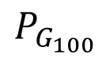
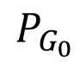
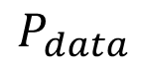
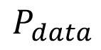
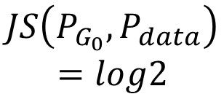
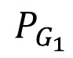
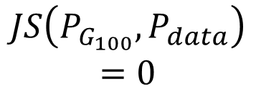
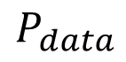
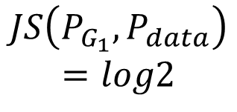
What is the problem of JS divergence?
$$P_{G_{0}}$$
$$P_{data}$$
$$P_{G_{1}}$$
$$P_{data}$$
$$P_{G_{100}}$$
$$P_{data}$$
……
Equally bad
$$JS\left(P_{G_{0}},P_{data}\right)$$
$$=log2$$
$$JS\left(P_{G_{1}},P_{data}\right)$$
$$=log2$$
$$JS\left(P_{G_{100}},P_{data}\right)$$
$$=0$$
……
JS divergence is log2 if two distributions do not overlap.
Intuition: If two distributions do not overlap, binary classifier achieves 100% accuracy
Same objective value is obtained.
Same divergence

Slide 4

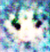
Least Square GAN (LSGAN)
real
generated
Replace sigmoid with linear (replace classification with regression)
Binary
Classifier
Binary
Classifier
scalar
scalar
1 (Real)
0 (Fake)
They don’t move.
1
0
Notes:
Move towards value 1

Slide 5

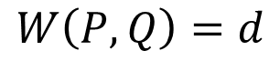
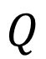
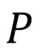
Wasserstein GAN (WGAN): Earth Mover’s Distance
Considering one distribution P as a pile of earth, and another distribution Q as the target
The average distance the earth mover has to move the earth.
$$P$$
$$Q$$
d
$$W\left(P,Q\right)=d$$
Notes:
http://www.wxlhcc.com/product/328294.html

Slide 6
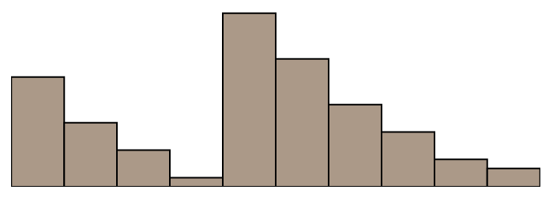
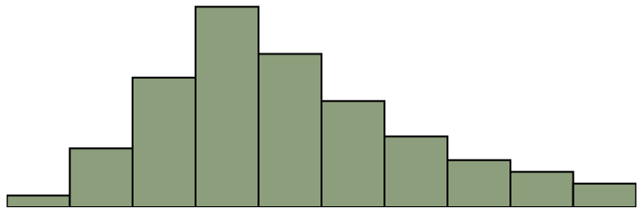
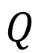
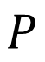
WGAN: Earth Mover’s Distance
Smaller distance?
Larger distance?
$$P$$
$$Q$$
There many possible “moving plans”.
Using the “moving plan” with the smallest average distance to define the earth mover’s distance.
Source of image: https://vincentherrmann.github.io/blog/wasserstein/

Slide 7
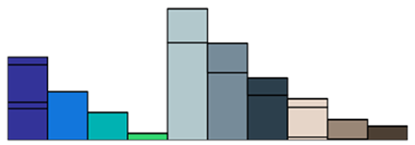
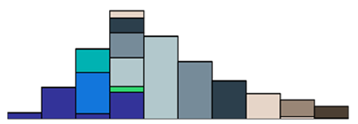
WGAN: Earth Mover’s Distance
Best “moving plans” of this example
$$P$$
$$Q$$
There many possible “moving plans”.
Using the “moving plan” with the smallest average distance to define the earth mover’s distance.
Source of image: https://vincentherrmann.github.io/blog/wasserstein/

Slide 8
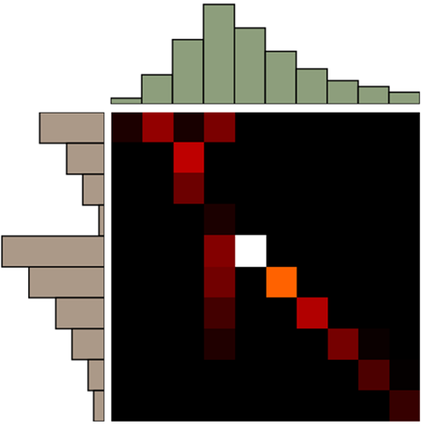
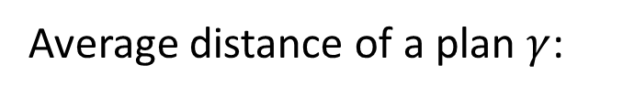
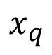
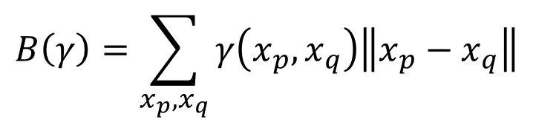
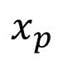
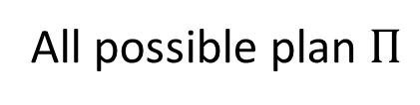
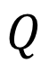
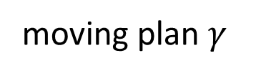
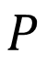

$$Q$$
$$x_{q}$$
A “moving plan” is a matrix
The value of the element is the amount of earth from one position to another.
$$P$$
Average distance of a plan $γ$:
$$B\left(γ\right)=\sum_{x_{p},x_{q}}{γ\left(x_{p},x_{q}\right)\left\|x_{p}−x_{q}\right\|}$$
Earth Mover’s Distance:
$$x_{p}$$
$$W\left(P,Q\right)=\min_{γ∈Π}{B\left(γ\right)}$$
moving plan $γ$
The best plan
All possible plan $Π$

Slide 9
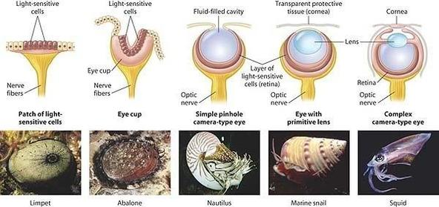
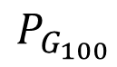
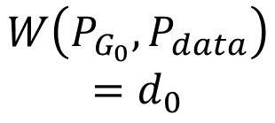
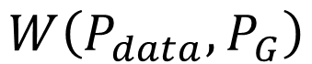
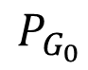
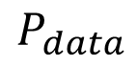
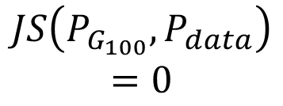
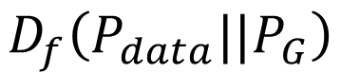
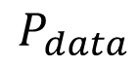
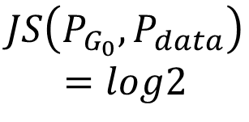
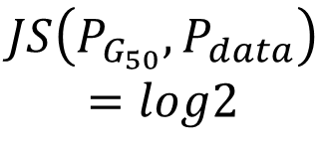
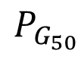
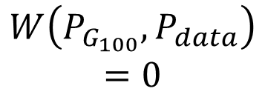
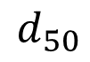
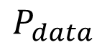
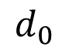
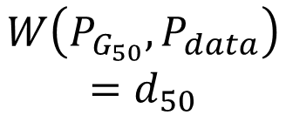
Why Earth Mover’s Distance?
$$D_{f}\left(P_{data}||P_{G}\right)$$
$$W\left(P_{data},P_{G}\right)$$
$$d_{0}$$
$$d_{50}$$
$$P_{G_{0}}$$
$$P_{data}$$
$$P_{G_{50}}$$
$$P_{data}$$
……
$$P_{G_{100}}$$
$$P_{data}$$
……
$$JS\left(P_{G_{0}},P_{data}\right)$$
$$=log2$$
$$JS\left(P_{G_{50}},P_{data}\right)$$
$$=log2$$
$$JS\left(P_{G_{100}},P_{data}\right)$$
$$=0$$
$$W\left(P_{G_{0}},P_{data}\right)$$
$$=d_{0}$$
$$W\left(P_{G_{50}},P_{data}\right)$$
$$=d_{50}$$
$$W\left(P_{G_{100}},P_{data}\right)$$
$$=0$$

Slide 10




WGAN
[Martin Arjovsky, et al., arXiv, 2017]
Evaluate wasserstein distance between $P_{data}$ and $P_{G}$
$$V\left(G,D\right)$$
$$=\max_{D∈1−Lipschitz}\left\{E_{x\sim P_{data}}\left[D\left(x\right)\right]−E_{x\sim P_{G}}\left[D\left(x\right)\right]\right\}$$
D has to be smooth enough.
$$∞$$
Without the constraint, the training of D will not converge.
generated
real
Keeping the D smooth forces D(x) become $∞$ and $−∞$
D
$$−∞$$
Notes:
利普希茨連
Simply speaking

Slide 11




WGAN
Weight Clipping
[Martin Arjovsky, et al., arXiv, 2017]
Force the parameters w between c and -c
After parameter update, if w > c, w = c; if w < -c, w = -c
Evaluate wasserstein distance between $P_{data}$ and $P_{G}$
$$V\left(G,D\right)$$
$$=\max_{D∈1−Lipschitz}\left\{E_{x\sim P_{data}}\left[D\left(x\right)\right]−E_{x\sim P_{G}}\left[D\left(x\right)\right]\right\}$$
D has to be smooth enough.
How to fulfill this constraint?
Lipschitz Function
$\text{1−}\text{Lipschitz}?$
$$\left\|f\left(x_{1}\right)−f\left(x_{2}\right)\right\|≤K\left\|x_{1}−x_{2}\right\|$$
Output change
Input
change
$\text{1−}\text{Lipschitz}?$
K=1 for $"1−Lipschitz"$
Do not change fast
Notes:
利普希茨連
Simply speaking

Slide 12







Improved WGAN (WGAN-GP)
$$V\left(G,D\right)$$
$$=\max_{D∈1−Lipschitz}\left\{E_{x\sim P_{data}}\left[D\left(x\right)\right]−E_{x\sim P_{G}}\left[D\left(x\right)\right]\right\}$$
A differentiable function is 1-Lipschitz if and only if it has gradients with norm less than or equal to 1 everywhere.
$$D∈1−Lipschitz$$
$$\left\|∇_{x}D\left(x\right)\right\|≤1 \text{for} \text{all} \text{x}$$
$$V\left(G,D\right)$$
$$≈\max_{D}\{E_{x\sim P_{data}}\left[D\left(x\right)\right]−E_{x\sim P_{G}}\left[D\left(x\right)\right]$$
$−λ\int_{x}{max\left(0,\left\|∇_{x}D\left(x\right)\right\|−1\right)dx}$}
Prefer $\left\|∇_{x}D\left(x\right)\right\|≤1$ for all x
$−{λE}_{x\sim P_{penalty}}\left[max\left(0,\left\|∇_{x}D\left(x\right)\right\|−1\right)\right]$}
Prefer $\left\|∇_{x}D\left(x\right)\right\|≤1$ for x sampling from $x\sim P_{penalty}$

Slide 13






Improved WGAN (WGAN-GP)
$$V\left(G,D\right)$$
$$≈\max_{D}\{E_{x\sim P_{data}}\left[D\left(x\right)\right]−E_{x\sim P_{G}}\left[D\left(x\right)\right]$$
$−{λE}_{x\sim P_{penalty}}\left[max\left(0,\left\|∇_{x}D\left(x\right)\right\|−1\right)\right]$}
$$P_{data}$$
$$P_{G}$$
$$P_{penalty}$$
“Given that enforcing the Lipschitz constraint everywhere is intractable, enforcing it only along these straight lines seems sufficient and experimentally results in good performance.”
Only give gradient constraint to the region between $P_{data}$ and $P_{G}$ because they influence how $P_{G}$ moves to $P_{data}$

Slide 14








Improved WGAN (WGAN-GP)
$$V\left(G,D\right)$$
$$≈\max_{D}\{E_{x\sim P_{data}}\left[D\left(x\right)\right]−E_{x\sim P_{G}}\left[D\left(x\right)\right]$$
$−{λE}_{x\sim P_{penalty}}\left[max\left(0,\left\|∇_{x}D\left(x\right)\right\|−1\right)\right]$}
$${\left(\left\|∇_{x}D\left(x\right)\right\|−1\right)}^{2}$$
$$P_{data}$$
$$P_{G}$$
Largest gradient in this region (=1)
$$D\left(x\right)$$
$$P_{penalty}$$
$$D\left(x\right)$$
“Simply penalizing overly large gradients also works in theory, but experimentally we found that this approach converged faster and to better optima.”

Slide 15


Spectrum Norm
Spectral Normalization $→$ Keep gradient norm smaller than 1 everywhere [Miyato, et al., ICLR, 2018]

Slide 16






WGAN
Algorithm of Original GAN
No sigmoid for the output of D
In each training iteration:
Sample m examples $\left\{x^{1},x^{2},…,x^{m}\right\}$ from data distribution $P_{data}\left(x\right)$
Sample m noise samples $\left\{z^{1},z^{2},…,z^{m}\right\}$ from the prior $P_{prior}\left(z\right)$
Obtaining generated data $\left\{{\tilde{x}}^{1},{\tilde{x}}^{2},…,{\tilde{x}}^{m}\right\}$, ${\tilde{x}}^{i}=G\left(z^{i}\right)$
Update discriminator parameters $θ_{d}$ to maximize
$\tilde{V}=\frac{1}{m}\sum_{i=1}^{m}{logD\left(x^{i}\right)}+\frac{1}{m}\sum_{i=1}^{m}{log\left(1−D\left({\tilde{x}}^{i}\right)\right)}$
$θ_{d}←θ_{d}+η∇\tilde{V}\left(θ_{d}\right)$
Sample another m noise samples $\left\{z^{1},z^{2},…,z^{m}\right\}$ from the prior $P_{prior}\left(z\right)$
Update generator parameters $θ_{g}$ to minimize
$\tilde{V}=\frac{1}{m}\sum_{i=1}^{m}{logD\left(x^{i}\right)}+\frac{1}{m}\sum_{i=1}^{m}{log\left(1−D\left(G\left(z^{i}\right)\right)\right)}$
$θ_{g}←θ_{g}−η∇\tilde{V}\left(θ_{g}\right)$
Learning
D
Repeat k times
$$D\left(x^{i}\right)$$
$$−$$
$$D\left({\tilde{x}}^{i}\right)$$
Weight clipping /
Gradient Penalty …
Learning
G
$$−$$
$$D\left(G\left(z^{i}\right)\right)$$
Only Once
Notes:
Using RMSProp instead of Adam

Slide 17


Energy-based GAN (EBGAN)
[Junbo Zhao, et al., arXiv, 2016]
Using an autoencoder as discriminator D
Using the negative reconstruction error of auto-encoder to determine the goodness
Benefit: The auto-encoder can be pre-train by real images without generator.
Generator is the same.
Discriminator
EN
DE
0.1
-
X -1
-0.1
Autoencoder
0 for the best images
Notes:
Ref: Junbo Zhao, Michael Mathieu, Yann LeCun, Energy-based Generative Adversarial Network, ICRL 2017

Slide 18
EBGAN
Auto-encoder based discriminator only gives limited region large value.
gen
real
gen
0 is for the best.
m
Do not have to be very negative
Hard to reconstruct, easy to destroy
Notes:
這個 discriminator 非常嚴格

Slide 19










Outlook: Loss-sensitive GAN (LSGAN)
WGAN
LSGAN
D(x)
D(x)
$$x$$
$$Δ\left(x,x′' \right)$$
$$x$$
$$Δ\left(x,x′ \right)$$
$$x′′$$
$$x′$$
$$x′′$$
$$x′$$

Slide 20
Reference
Ian J. Goodfellow, Jean Pouget-Abadie, Mehdi Mirza, Bing Xu, David Warde-Farley, Sherjil Ozair, Aaron Courville, Yoshua Bengio, Generative Adversarial Networks, NIPS, 2014
Sebastian Nowozin, Botond Cseke, Ryota Tomioka, “f-GAN: Training Generative Neural Samplers using Variational Divergence Minimization”, NIPS, 2016
Martin Arjovsky, Soumith Chintala, Léon Bottou, Wasserstein GAN, arXiv, 2017
Ishaan Gulrajani, Faruk Ahmed, Martin Arjovsky, Vincent Dumoulin, Aaron Courville, Improved Training of Wasserstein GANs, NIPS, 2017
Junbo Zhao, Michael Mathieu, Yann LeCun, Energy-based Generative Adversarial Network, arXiv, 2016
Mario Lucic, Karol Kurach, Marcin Michalski, Sylvain Gelly, Olivier Bousquet, “Are GANs Created Equal? A Large-Scale Study”, arXiv, 2017
Tim Salimans, Ian Goodfellow, Wojciech Zaremba, Vicki Cheung, Alec Radford, Xi Chen Improved Techniques for Training GANs, NIPS, 2016
Notes:
Xi Chen, Yan Duan, Rein Houthooft, John Schulman, Ilya Sutskever, Pieter Abbeel, InfoGAN: Interpretable Representation Learning by Information Maximizing Generative Adversarial Nets, NIPS, 2015

Slide 21
Reference
Martin Heusel, Hubert Ramsauer, Thomas Unterthiner, Bernhard Nessler, Sepp Hochreiter, GANs Trained by a Two Time-Scale Update Rule Converge to a Local Nash Equilibrium, NIPS, 2017
Naveen Kodali, Jacob Abernethy, James Hays, Zsolt Kira, “On Convergence and Stability of GANs”, arXiv, 2017
Xiang Wei, Boqing Gong, Zixia Liu, Wei Lu, Liqiang Wang, Improving the Improved Training of Wasserstein GANs: A Consistency Term and Its Dual Effect, ICLR, 2018
Takeru Miyato, Toshiki Kataoka, Masanori Koyama, Yuichi Yoshida, Spectral Normalization for Generative Adversarial Networks, ICLR, 2018

